Slide 1
Project Title Group #x
ECE 372A – Microcontroller organization
Electrical and computer engineering
University of Arizona

Slide 2
Team Members
List team members and roles of each member
Also include team number

Slide 3
Statement of Problem
Describe the problem you are trying to solve

Slide 4
Proposed Prototype Solution
Briefly describe your proposed prototype solution

Slide 5
Requirements
Requirement 1 – State each requirement and how you will measure the outcome
Requirement 2
Requirement 3
Requirement 4
…..

Slide 6
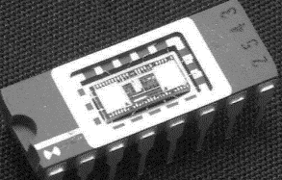
System Architecture Diagram
Example
Brief description of key features
…..
…..
….
H₂ Chip

Slide 7
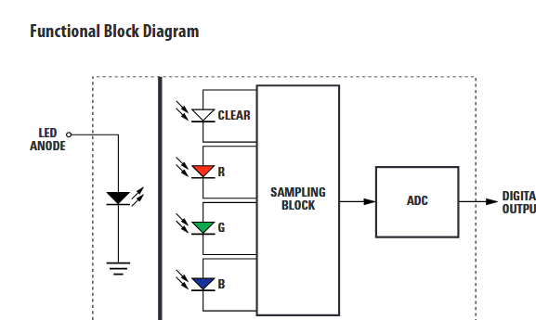
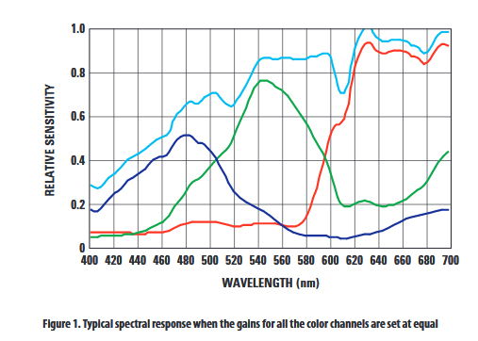
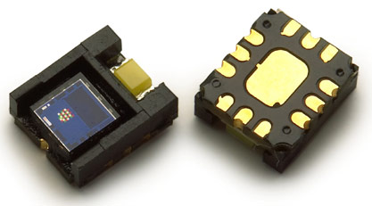
Input Sensor type(s)
One slide for each sensor with relevant performance specifications (spec sheet data such as resolution, range, data rate, etc…).
Example -
Avago ADJD-S371-QR999
RGB Digital Color Sensor Module

Slide 8
Output Devices
List the type of Output device(s). Include relevant spec sheet data if applicable.

Slide 9
Software Functions – Brief Description
Brief description of software functions written for project
Example (ADC, Timer, Communication, servo driver,…..

Slide 10
Communication Protocol
Description of Protocol Used. Include Timing diagram

Slide 11
Circuit Diagram
You can use Fritzing to draw your circuit diagram.

Slide 12
Mechanical Diagram
How will your system be packaged and integrated into your system application?
A conceptual diagram showing what your prototype would look like.
You should include some dimensions

Slide 13
Power requirements
Total power requirements and estimated battery life if it is a portable system.
Include power needed for microcontroller.

Slide 14
Bill of Materials
Include the cost of sensors, microcontroller platform, batteries, etc.

Slide 15
Results
Show key results.

Slide 16
Final Rubric
Show final rubric with your score (example)

Slide 17
Summary Slide
Summary and Next Steps - What are the follow-on ideas to pursue?

